Slide 1
Advanced Network Design EETS8332
© Dr. Scott Kingsley

Slide 2
Optical Transport Network (OTN)
OTN builds upon the concepts of SONET/SDH and has been designed to carry all types of data traffic including SONET/SDH traffic.
It has been enhanced to operate at very high transmission rates, and it has a complete and flexible set of operation and management features.
© Dr. Scott Kingsley

Slide 3
Optical Transport Network (OTN)
OTN is an industry-standard optical transport protocol
ITU G.872 "Architecture for the Optical Transport Network (OTN)” (Oct 2001)
Further refined in ITU-T G.709 Jan 2003
Amendment 3 Oct 2009

Slide 4
Optical Transport Network (OTN)
ITU G.709
Designed to transport data packet traffic such as IP and Ethernet over fiber optics, as well as legacy traffic and in particular SONET/SDH.
It is called the digital wrapper technology because it wraps any client signal in overhead information for operations, administration, and management.

Slide 5
Optical Transport Network (OTN)
Asynchronous timing
OTN has an asynchronous mapping of client signals into OTN frames where the clock that generates the frames can be a simple free-running oscillator.
To account for any mismatch between the clocks of the OTN frames and the client signal, the OTN payload floats within the frame.
Simple free-running oscillators can simplify implementation and reduce costs.
Unlike SONET/SDH, as the line rate increases, the G.709 frame size (4 x 4080) remains the same and the frame rate increases.
This is a fundamental departure from the 8 kHz/64kbps PCM frame rate that has been a foundation of digital telecommunication networks

Slide 6
Optical Transport Network (OTN)
Asynchronous timing
OTN has an asynchronous mapping of client signals into OTN frames where the clock that generates the frames can be a simple free-running oscillator.
To account for any mismatch between the clocks of the OTN frames and the client signal, the OTN payload floats within the frame.
Simple free-running oscillators can simplify implementation and reduce costs.
Unlike SONET/SDH, as the line rate increases, the G.709 frame size (4 x 4080) remains the same and the frame rate increases.
This is a fundamental departure from the 8 kHz/64kbps PCM frame rate that has been a foundation of digital telecommunication networks

Slide 7
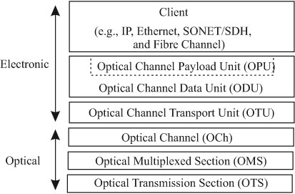
OTN Hierarchy
The optical transmission section (OTS), optical multiplexed section (OMS), and optical channel (OCh) layers are in the optical domain.
The OTS layer manages fiber link segments between optical components such as between optical amplifiers, or optical amplifiers and WDM multiplexers.
The OMS layer manages fiber links between optical multiplexers and switches.
The OCh layer manages optical connections between 3R regenerators (e.g., lightpaths).

Slide 8
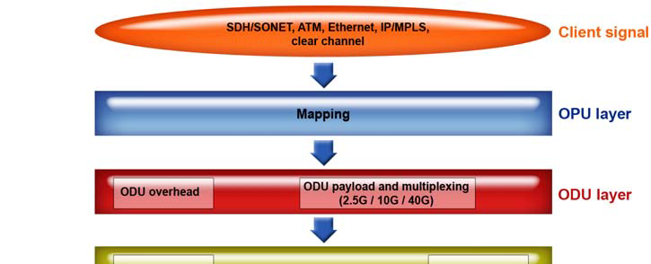
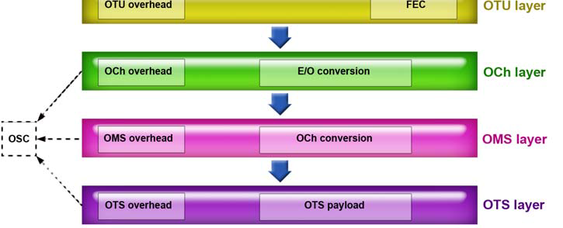
OTN Hierarchy

Slide 9
OTN Hierarchy
The OPU (Optical Payload Unit) maps (encapsulates, digitally wrapping) the Client signal (e.g. SONET/SDH, IP-packets, ATM cells, Ethernet frames) and performs rate justification, if needed.
The ODU (Optical Channel Data Unit) consists of the OPU and the ODU overhead.
The ODU overhead functionality is similar to the path overhead in SONET/SDH.
It provides multiplexing, protection switching, end-to-end path supervision, tandem connection monitoring, BIP for signal quality supervision, maintenance signals, and data communication channels.
The OTU (Optical Channel Transport Unit) is the highest layer in the electrical domain. Its functionality is similar to the Section Overhead in SONET/SDH and includes BIP calculation, Trail Trace ID, and Forward Error Correction (FEC).

Slide 10
OTN Hierarchy
The OCh (Optical Channel) performs electrical to optical signal conversion and modulates the DWDM wavelength (ITU-T grid) carrier.
The OMS (Optical Multiplex Section) multiplexes several wavelengths, each carrying one OCh into one fiber. The OMS layer refers to the section between an optical multiplexer and demultiplexer.
The OTS (Optical Transmission Section) exists between each of the in-line optical amplifier units.

Slide 11
Optical Transport Network (OTN) Hierarchy
Signal Level | Data Rate (Gbit/s) (Approximate) | Typical Applications
ODU1 | 2.5 Gbps | Transport of two ODU0 signals or a STS-48/STM-16 signal or a stream of packets (such as Ethernet, MPLS or IP) using Generic Framing Procedure.
ODU2 | 10 Gbps | Transport of up to eight ODU0 signals or up to four ODU1 signals or a STS-192/STM-64 signal or a WAN PHY (10GBASE-W) or a stream of packets (such as Ethernet, MPLS or IP) using Generic Framing Procedure
ODU3 | 40 Gbps | Transport of up to 32 ODU0 signals or up to 16 ODU1 signals or up to four ODU2 signals or a STS-768/STM-256 signal or a timing transparent transcoded 40 Gigabit Ethernet signal or a stream of packets (such as Ethernet, MPLS or IP) using Generic Framing Procedure

Slide 12
Optical Transport Network (OTN) Hierarchy Added in 2009
ODU0 | 1.25 Gbps | Transport of a timing transparent transcoded (compressed) 1000BASE-X signal^{[3]} or a stream of packets (such as Ethernet, MPLS or IP) using Generic Framing Procedure
ODU2e | 10 Gbps | Transport of a 10 Gigabit Ethernet signal or a timing transparent transcoded (compressed) Fibre Channel 10GFC signal
ODU3 | 40 Gbps | Transport of up to 32 ODU0 signals or up to 16 ODU1 signals or up to four ODU2 signals or a STS-768/STM-256 signal or a timing transparent transcoded 40 Gigabit Ethernet signal or a stream of packets (such as Ethernet, MPLS or IP) using Generic Framing Procedure
ODU3e2 | 41 Gbps | Transport of up to four ODU2e signals
ODU4 | 105 Gbps | Transport of up to 80 ODU0 signals or up to 40 ODU1 signals or up to ten ODU2 signals or up to two ODU3 signals or a 100 Gigabit Ethernet signal
ODUflex(CBR) | client bit rate | Transport of a Constant bitrate signal such as Fibre Channel 8GFC, InfiniBand or Common Public Radio Interface
ODUflex(GFP) | configured rate | Transport of a stream of packets (such as Ethernet, MPLS or IP) using Generic Framing Procedure

Slide 13
What is MPLS?
MPLS stands for "Multiprotocol Label Switching.”
In an MPLS network, incoming packets are assigned a "label" by a "label edge router (LER)".
Packets are forwarded along a "label switch path (LSP)" where each "label switch router (LSR)" makes forwarding decisions based solely on the contents of the label.
At each hop, the LSR strips off the existing label and applies a new label which tells the next hop how to forward the packet.
© Dr. Kingsley

Slide 14
What is MPLS?
Label Switch Paths (LSPs) are established by network operators for a variety of purposes, such as to guarantee a certain level of performance, to route around network congestion, or to create IP tunnels for network-based virtual private networks.
In many ways, LSPs are no different than circuit-switched paths in ATM or Frame Relay networks, except that they are not dependent on a particular Layer 2 technology.
© Dr. Kingsley

Slide 15
What is MPLS?
An LSP can be established that crosses multiple Layer 2 transports such as ATM, Frame Relay or Ethernet.
Thus, one of the true promises of MPLS is the ability to create end-to-end circuits, with specific performance characteristics, across any type of transport medium, eliminating the need for overlay networks or Layer 2 only control mechanisms.”
© Dr. Kingsley

Slide 16
What is MPLS?
Network World
“Multiprotocol Label Switching has been without a doubt one of the most successful technologies of the past decade. The advantages of MPLS are many: in addition to protocol neutrality, MPLS is highly scalable and can intelligently route time-sensitive voice and video packets through low-latency routes throughout the network. Because of these key features MPLS has been widely adopted by enterprises for their WANs, as the most recent data from Nemertes Research indicates that around 84% of companies are now using MPLS for their WANs.”
© Dr. Kingsley

Slide 17
What is MPLS?
OK now in plain English now please?
Packets enter MPLS Network at a “Label Edge Router” (LER).
LER apply a label to packet and forwards it to the MPLS network.
Label switches in the network at each hop makes forwarding decision solely based on label.
That decision is made based on a pre-established “Label Switch Path” (LSP).
Labels can be integrated with existing L2 info such as DLCI or ATM VCs.
© Dr. Kingsley

Slide 18
MPLS Motivation
Original drivers towards label switching:
Designed to make routers faster
ATM switches were faster than routers
Fixed length label lookup faster than longest match used by IP routing
Allow a device to do the same job as a router with performance of ATM switch
Enabled IP + ATM integration
Mapping of IP to ATM had become very complex, hence simplify by replacing ATM signalling protocols with IP control protocols
© Dr. Kingsley

Slide 19
Some MPLS Benefits
Traffic Engineering
The ability to set the path traffic will take through the network, and the ability to set performance characteristics for a class of traffic.
VPNs
Using MPLS, service providers can create IP tunnels throughout their network, without the need for encryption or end-user applications.
Layer 2 Transport
New standards being defined by the IETF's PWE3 and PPVPN working groups allow service providers to carry Layer 2 services including Ethernet, Frame Relay and ATM over an IP/MPLS core.
Restoration
© Dr. Kingsley

Slide 20
Some MPLS Benefits
Elimination of Multiple Layers
Typically most carrier networks employ an overlay model where SONET/SDH is deployed at Layer 1, ATM is used at Layer 2 and IP is used at Layer 3.
Using MPLS, carriers can migrate many of the functions of the SONET/SDH and ATM control plane to Layer 3, thereby simplifying network management and network complexity.
Eventually, carrier networks may be able to migrate away from SONET/SDH and ATM all-together, which means elimination of ATM's inherent "cell-tax" in carrying IP traffic.
Restoration of failed traffic in SONET timeframe without the capacity requirements.
© Dr. Kingsley

Slide 21
MPLS and OSI Model (MPLS is a “Layer 2.5” protocol)
Applications
TCP
UDP
IP
MPLS
MPλS
DWDM
PPP
FR
ATM
Ethernet
Physical
© Dr. Kingsley

Slide 22
Label Switching
What is it?
Goal: sending a packet from A to B
Broadcasts
Hop-by-hop
Source routing
© Dr. Kingsley

Slide 23
Labels are not new!
ATM: VPI/VCI
Frame Relay: DLCI
X.25: LCI (logical Channel Identifier)
TDM: the time slot (Circuit Identification Code
© Dr. Kingsley

Slide 24

Label Swapping
Label-A1
Label-B1
Label-A2
Label-B2
Label-A3
Label-B3
Label-A4
Label-B4
Labels are only locally significant!!
© Dr. Kingsley

Slide 25
MPLS
Uses “source routing.”
A hop-by-hop forwarding mechanism.
Use labels to set up the path
Require a protocol to set up the labels along the path
It builds a connection-oriented service on the IP network.
© Dr. Kingsley

Slide 26
Terminology
Label Switch Router (LSR)
Routers that support MPLS are called Label Switch Router
Label Edge Router (LER)
LSR at the edge of the network is called Label Edge Router (a.k.a Edge LSR)
Ingress LER is responsible for adding labels to unlabeled IP packets and determining the route through network.
Egress LER is responsible for removing the labels.
Label Switch Path (LSP)
The path defined by the labels through LSRs between two LERs.
Label Forwarding Information Base (LFIB)
A forwarding table (mapping) between labels to outgoing interfaces.
Forward Equivalent Class (FEC)
All IP packets follow the same path on the MPLS network and receive the same treatment at each node.
© Dr. Kingsley

Slide 27
FEC
A packet can be mapped to a particular FEC based on the following criteria:
Destination IP address
Source IP address
TCP/UDP port
Class of Service (CoS) or Type of Service (ToS),
Application used
Any combination of the previous criteria or others.
© Dr. Kingsley

Slide 28
Label Process
Label Switch Path
Routing Protocol
FEC
FEC
FEC
Label Assignment
Label Swapping
Label removal
Classification
Label assignment
LFIB
LFIB
LFIB
Layer 2
Layer 2
Layer 2
Layer 2
Layer 2
Layer 1
Layer 1
Layer 1
Layer 1
Layer 1
Ingress
Node
Core
Node
Egress
Node
© Dr. Kingsley

Slide 29

How does it work?
Add label at the ingress LER
Remove label at the egress LER
LSR
LSR
LER
LER
IP
IP
#L1
IP
#L2
IP
#L3
IP
IP
Routing
Label
Switching
Label
Switching
IP
Routing
© Dr. Kingsley

Slide 30
MPLS Operation
1. Routing protocols (e.g. OSPF-TE, IS-IS-TE) exchange reachability to destination networks.
5. LER at egress removes label and delivers packet
2. Resource Reservation Protocol (RSVP) reserves resources and sets up LSP including labels needed.
IP
IP
4
IP
9
IP
IP
12
3. Ingress LER receives packet and labels packets
4. LSR forwards packets using label swapping
© Dr. Kingsley

Slide 31
MPLS Example: Forwarding Packets
In
Label
Address
Prefix
Out
I’face
Out Label
In
Label
Address
Prefix
Out
I’face
Out Label
In
Label
Address
Prefix
Out
I’face
Out Label
-
128.89
1
4
4
128.89
0
9
9
128.89
0
-
-
171.69
1
5
5
171.69
1
7
…
…
…
…
…
…
…
…
…
…
…
…
0
128.89
1/4
0/9
1/5
1/7
Note : Label Stacking
Label (20 bits)
Exp (3 bits)
S
(1 bit)
TTL
(8 bits)
171.69
© Dr. Kingsley

Slide 32
Label Stacking
A packet may carry multiple labels, organized as a last-in-first-out stack.
A label may be added to/removed from the stack at any LSR.
Processing always done on the top label
Allow the aggregation of LSPs into a single LSP for a portion of the route, creating a tunnel
At the beginning of the tunnel, the LSR assigns the same label to packets from different LSPs by pushing the label onto each packet’s stack
At the end of the tunnel, the LSR pops the top label
© Dr. Kingsley

Slide 33
Packet Forwarding (Again)
LER
LSR
LER
LSR
IP1
IP1
#L1
IP1
#L2
IP1
#L3
IP1
IP2
IP2
#L1
IP2
#L2
IP2
#L3
IP2
IP3
IP3
#L4
IP3
#L5
IP3
#L6
IP3
IP4
IP4
#L4
IP4
#L5
IP4
#L6
IP4
© Dr. Kingsley

Slide 34
Ethernet
Ethernet started as a local-area network (LAN) using a coaxial cable.
Today, it is carried over all communication physical media including twisted pair, wireless, and fiber optic cables.
It offers a wide range of data rates: 10 Mb/s, 100 Mb/s, 1 Gb/s, and 10 Gb/s.
Ethernet spans the data link and physical layers.
© Dr. Scott Kingsley

Slide 35
Carrier Ethernet
What is Carrier Ethernet?
Carrier Ethernet Terminology
The UNI, NNI, MEN.
Ethernet Virtual Connections (EVCs)
EVCs and Services
E-Line Services
Ethernet Private Line
Ethernet Virtual Private Line
E-LAN Services
Multipoint Services
E-Tree Services
Service Attributes
Service Parameters
Bandwidth Profiles
Traffic Management
March 2007

Slide 36
Carrier Ethernet
What is Carrier Ethernet?
Carrier Ethernet Terminology
The UNI, NNI, MEN.
Ethernet Virtual Connections (EVCs)
EVCs and Services
E-Line Services
Ethernet Private Line
Ethernet Virtual Private Line
E-LAN Services
Multipoint Services
E-Tree Services
Service Attributes
Service Parameters
Bandwidth Profiles
Traffic Management
March 2007

Slide 37

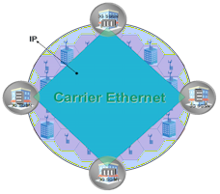

















Carrier Ethernet Scope and Reach
Bringing vastly extended scalability for business and residential users
Internet
HD TV
TVoD, VoD
Gaming, Business
Backup, ERP
Voice/Video
Telephony
Voice Gateway
Wireless Backhaul
Video
Source
Video
Source
COPPER, FIBER, COAX and WIRELESS
E-Line and
E-LAN service
Broadband
mobile data/video
Small/Medium Business
Residential
Triple-Play
FTTx and DSLAM , Cable Modem
March 2007

Slide 38
Metro Ethernet Forum (MEF)
“The MEF, as the defining body for Carrier Ethernet is a global industry alliance comprising more than 175 organizations including telecommunications service providers, cable MSOs, network equipment/software manufacturers, semiconductors vendors and testing organizations.
The MEF’s mission is to accelerate the worldwide adoption of Carrier-class Ethernet networks and services.
The MEF develops Carrier Ethernet technical specifications and implementation agreements to promote interoperability and deployment of Carrier Ethernet worldwide.”
http://metroethernetforum.org/index.php
March 2007

Slide 39



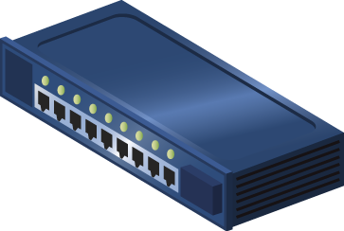
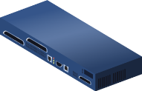
MEF Carrier Ethernet Terminology
The User Network Interface (UNI)
The UNI is the physical interface or port that is the demarcation between the customer and the service provider/Cable Operator/Carrier/MSO
The UNI is always provided by the Service Provider
The UNI in a Carrier Ethernet Network is a physical Ethernet Interface at operating speeds 10Mbs, 100Mbps, 1Gbps or 10Gbps
Carrier Ethernet Network
CE
UNI
CE: Customer Equipment, UNI: User Network Interface. MEF certified Carrier Ethernet products

Slide 40
MEF Carrier Ethernet Terminology
Ethernet Virtual Connection (EVC)
Service container
Connects two or more subscriber sites (UNI’s)
An association of two or more UNIs
Prevents data transfer between sites that are not part of the same EVC
Two types of EVCs
Point-to-Point
Multipoint-to-Multipoint
Can be bundled or multiplexed on the same UNI

Slide 41




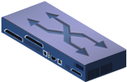





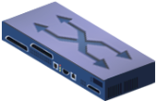



Carrier Ethernet: Two Service Types Using EVCs
E-Line Service used to create
Ethernet Private Lines
Virtual Private Lines
Ethernet Internet Access
E-LAN Service used to create
Multipoint L2 VPNs
Transparent LAN Service
Foundation for IPTV and Multicast networks etc.
Point-to-Point EVC
UNI
UNI
CE
CE
E-Line Service type
CE
UNI
UNI
Multipoint-to-Multipoint EVC
CE
E-LAN Service type
MEF certified Carrier Ethernet products
UNI: User Network Interface, CE: Customer Equipment

Slide 42



Services Using E-Line Service Type
Ethernet Private Line (EPL)
Replaces a TDM Private line
Dedicated UNIs for Point-to-Point connections
Single Ethernet Virtual Connection (EVC) per UNI
The most popular Ethernet service due to its simplicity
Storage Service Provider
UNI
UNI
Carrier Ethernet Network
CE
CE
UNI
ISP
POP
Internet
Point-to-Point EVC
UNI
CE

Slide 43








Services Using E-Line Service Type
Ethernet Virtual Private Line (EVPL)
Replaces Frame Relay or ATM services
Supports Service Multiplexed UNI (i.e. multiple EVCs per UNI)
Allows single physical connection (UNI) to customer premise equipment for multiple virtual connections
ISP
POP
Service Multiplexed Ethernet UNI
Internet
UNI
UNI
CE
Carrier Ethernet Network
CE
UNI
CE
Point-to-Point EVC
CE

Slide 44


Services Using E-LAN Service Type
Ethernet Private LAN and Ethernet Virtual Private LAN Services
Supports dedicated or service-multiplexed UNIs
Supports transparent LAN services and multipoint Layer 2 VPNs
Service Multiplexed Ethernet UNI
UNI
UNI
CE
Carrier Ethernet Network
UNI
CE
UNI
Point-to-Multipoint EVC
CE

Slide 45
Services Using E-Tree Service Type
Ethernet Private Tree (EP-Tree) and Ethernet Virtual Private Tree (EVP-Tree) Services
Provides traffic separation between users with traffic from one “leaf” being allowed to arrive at one of more “Roots” but never being transmitted to other “leaves”
Targeted at multi-host and where user traffic must be kept invisible to other users
Anticipated to be an enabler for mobile backhaul and triple-play infrastructure rather than end-user SLAs
Leaf
UNI
UNI
CE
Root
Leaf
UNI
UNI
Leaf
CE
CE
Carrier Ethernet Network
UNI
CE
See examples at the end of presentation. E-Tree is referenced in MEF 10.1 as Rooted-Multipoint EVC.

Slide 46
END OF SESSION 2

